Slide 1
Update on Bachelor Thesis
23.09.2024

Slide 2
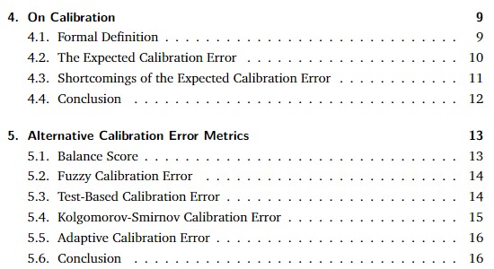
Written Thesis
Introductory Chapter
Concepts Chapter:
Calibration
True Expected Calibration Error
ECE
all alternative Metrics
https://www.overleaf.com/read/hzhhzvtfkmkz#ca9a3b

Slide 3
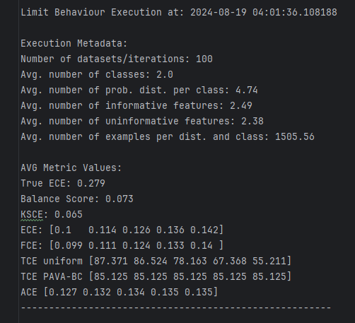
Code Base
Exhaustive Calculation
Qualitative Analysis:
Mean Deviation
Variance Deviation
Sine (Phase Shift)

Slide 4
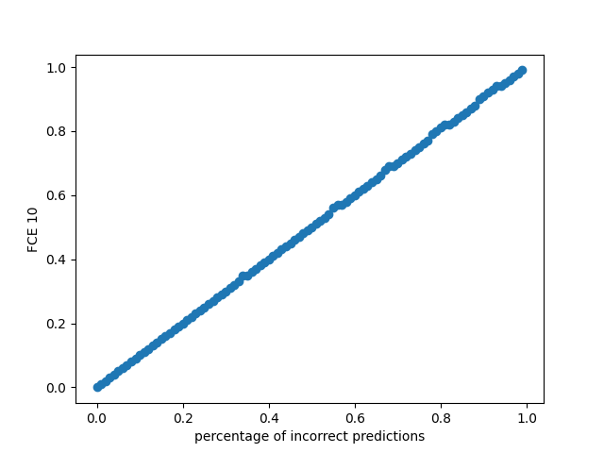
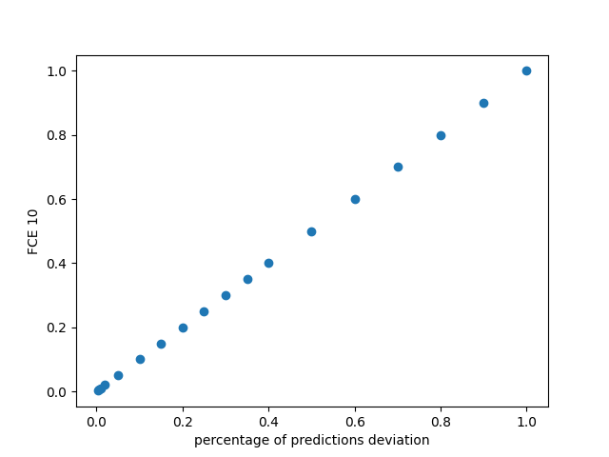
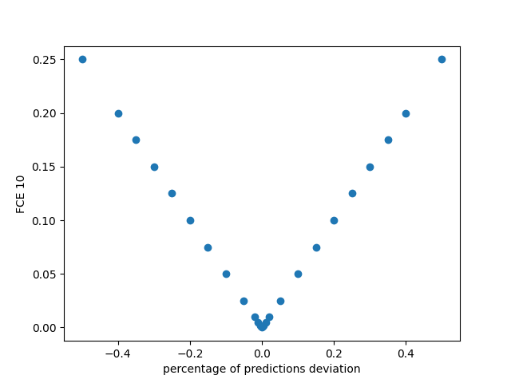
Exemplary Plots of Qualitative Analysis
Varying percentage of incorrect predictions
Varying percentage of prediction deviation
Investigating symmetry when varying percentage of prediction deviation from 50% initial probability

Slide 5
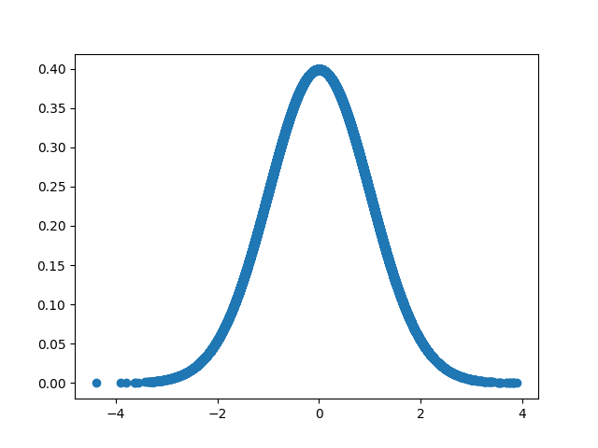
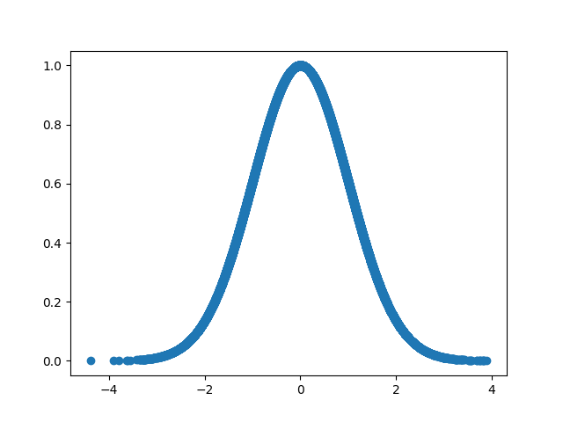
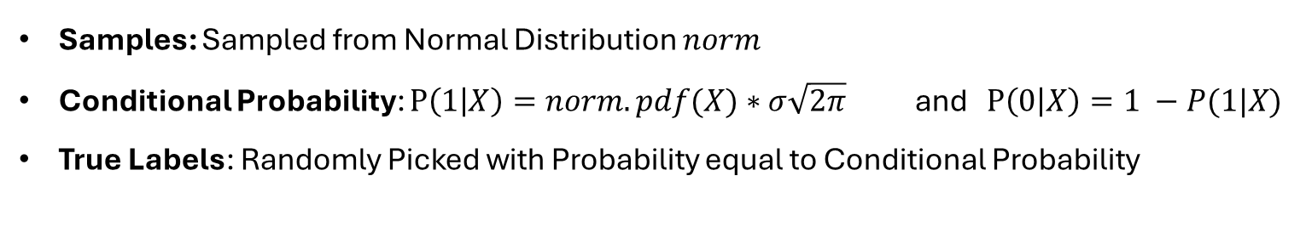

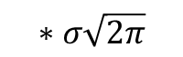
Setup
Qualitative Analysis
Samples: Sampled from Normal Distribution $norm$
Conditional Probability: $P\left(1 | X\right)=norm.pdf(X)∗σ\sqrt{2π}$ and $P\left(0 | X\right)=1 −P(1|X)$
True Labels: Randomly Picked with Probability equal to Conditional Probability
Normal Distribution $norm$
Conditional Probabilities for Class Label 1
$$∗σ\sqrt{2π}$$

Slide 6
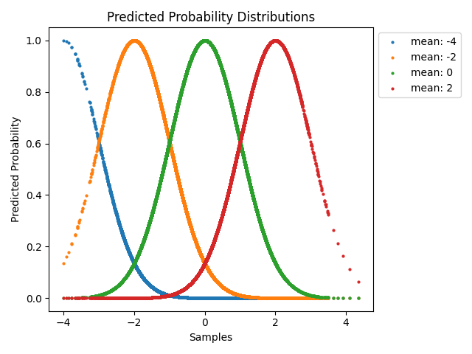
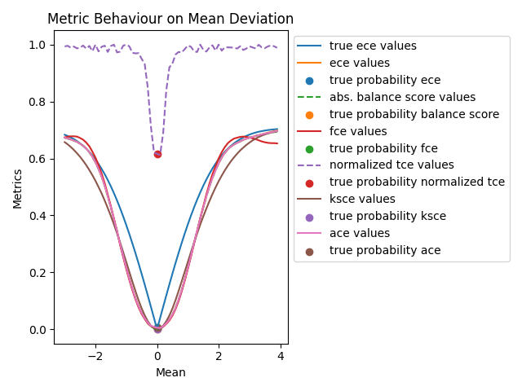

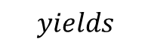
Mean Deviation
Qualitative Analysis
Fix True Probabilities and True Labels (see Setup)
Deviate Mean of $norm$ and scale again to obtain Predicted Probabilities
$$yields$$
sample size: 40000

Slide 7
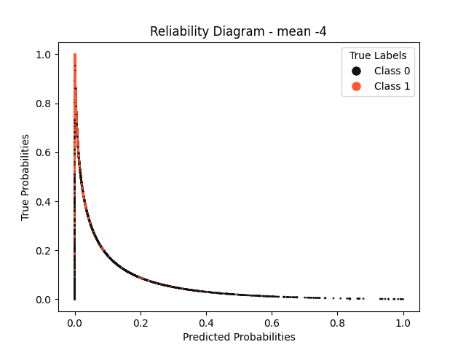
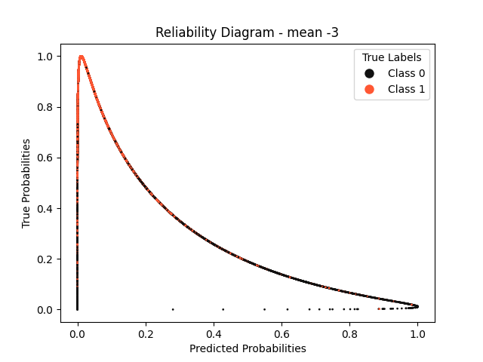
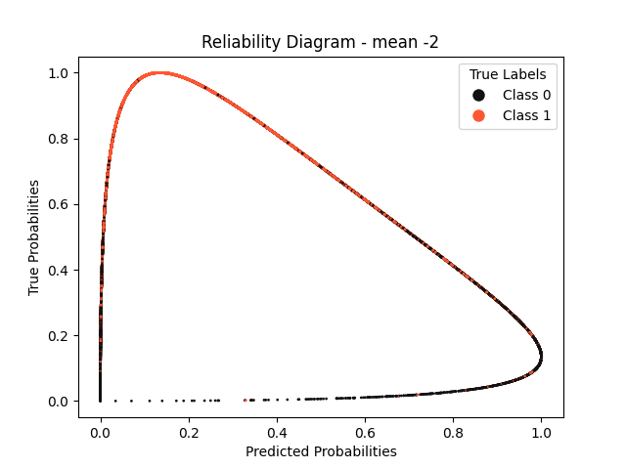
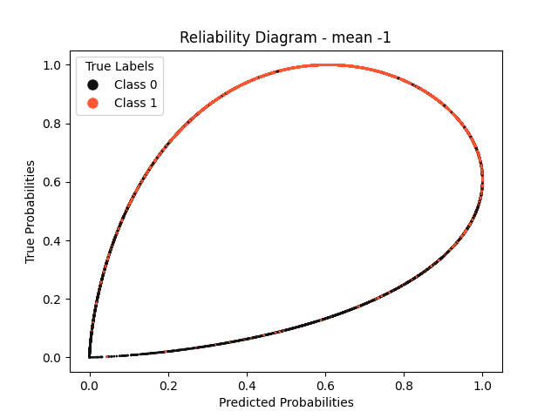
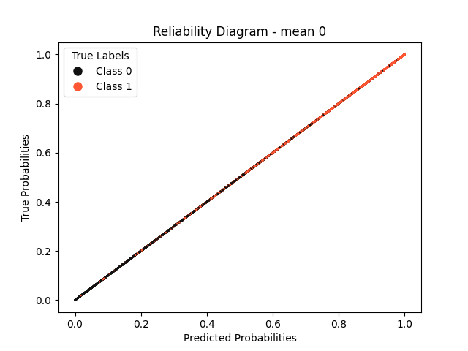
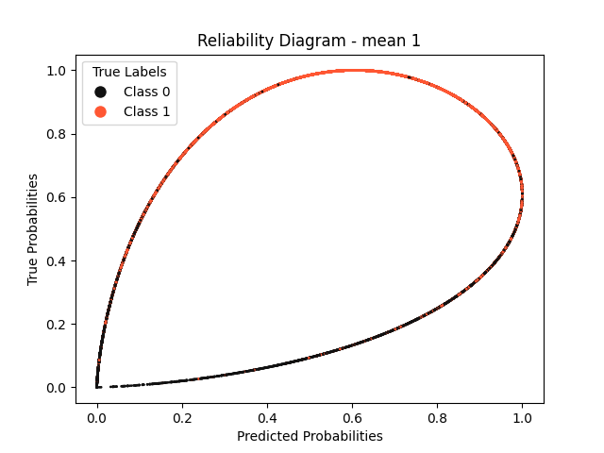
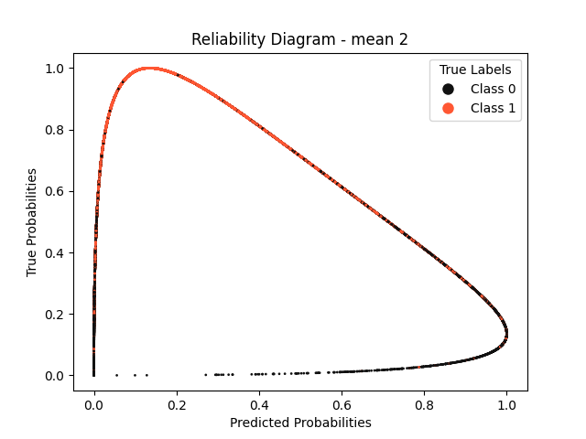

Reliability Diagrams – Mean Deviation

Slide 8
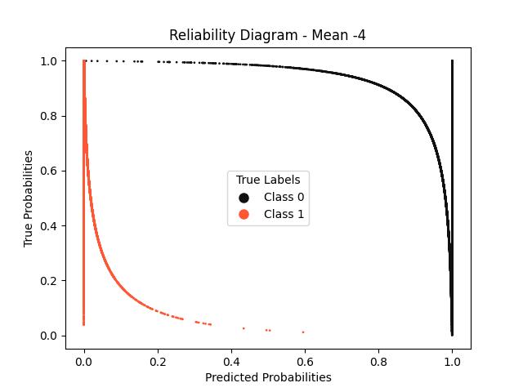
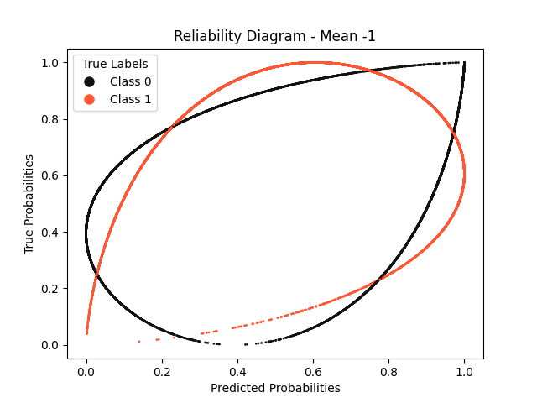
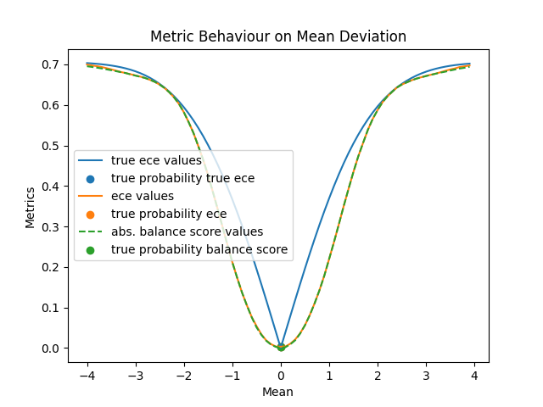
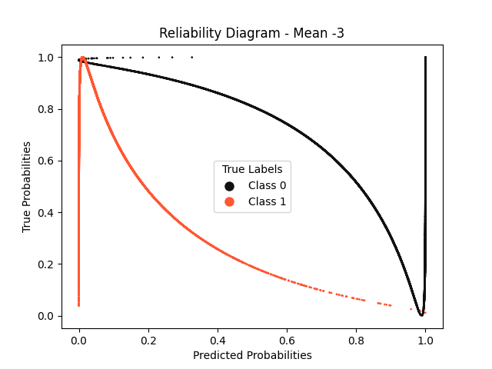
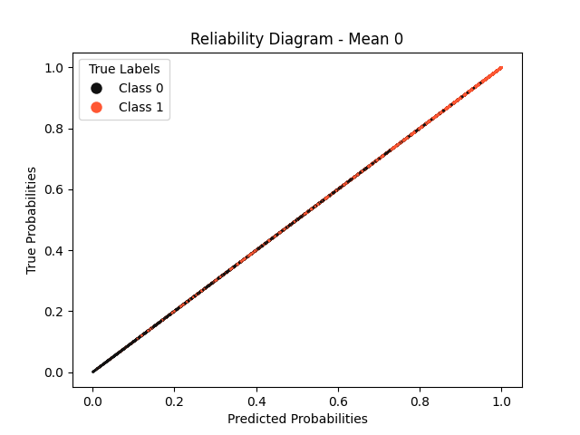
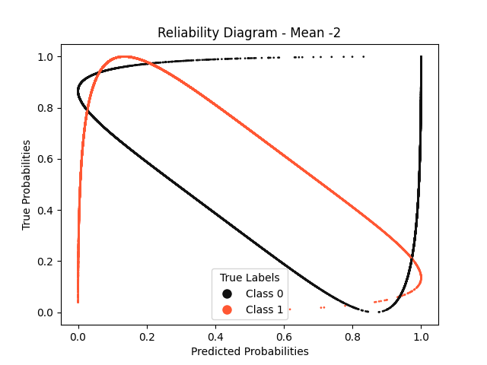


Slide 9
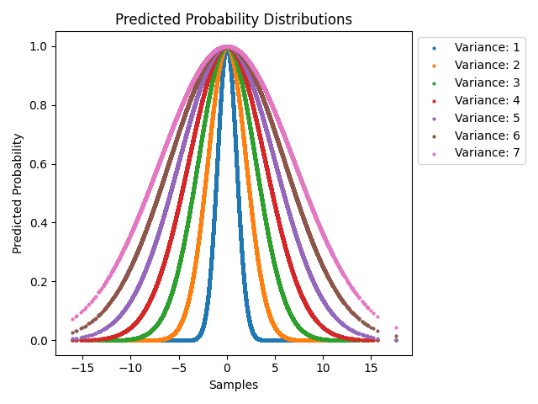
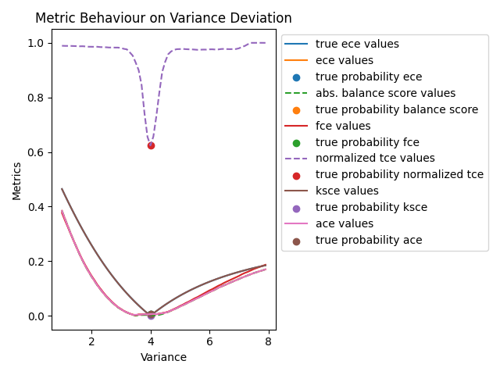
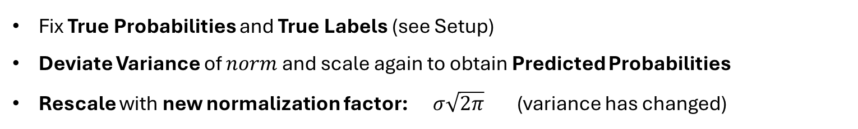
Variance Deviation (Dynamic Rescaling)
Qualitative Analysis
Fix True Probabilities and True Labels (see Setup)
Deviate Variance of $norm$ and scale again to obtain Predicted Probabilities
Rescale with new normalization factor: $σ\sqrt{2π}$ (variance has changed)
$$yields$$
sample size: 40000

Slide 10
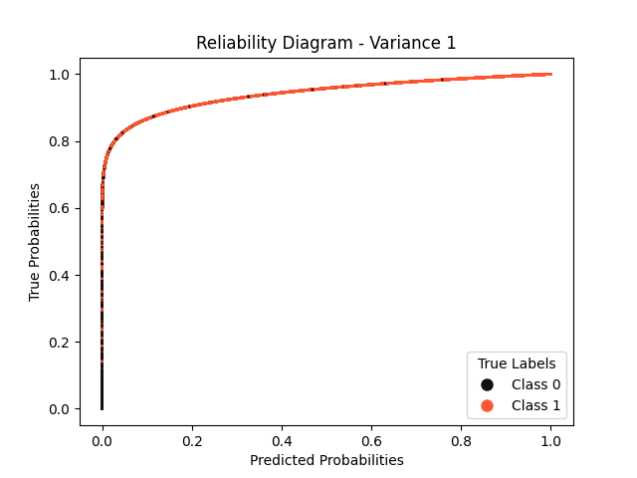
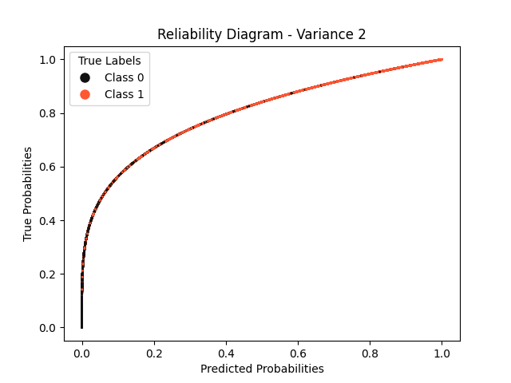
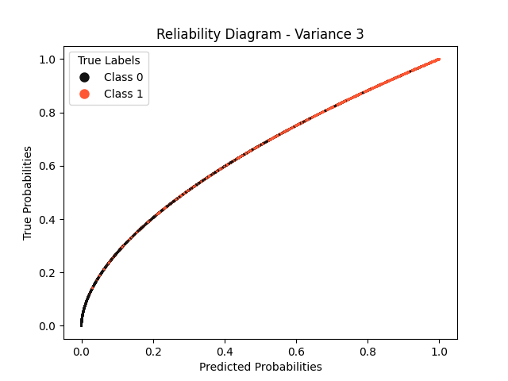
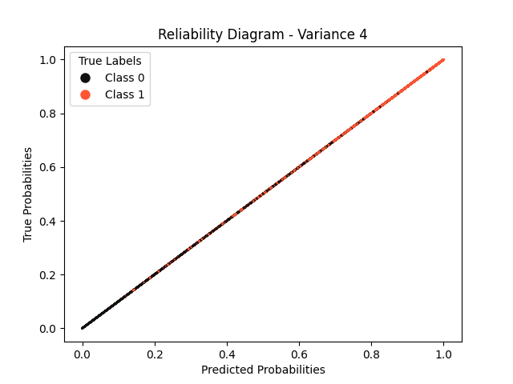
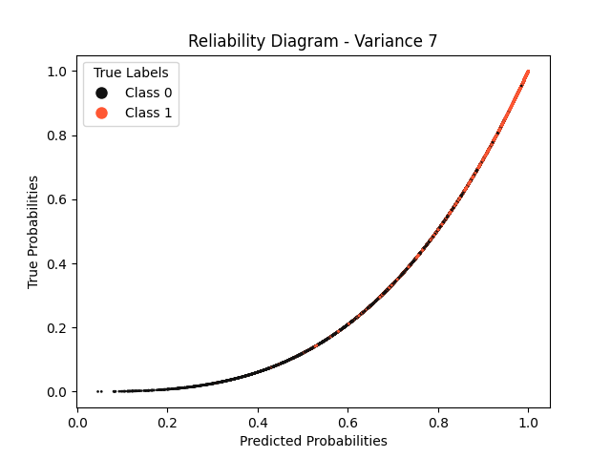
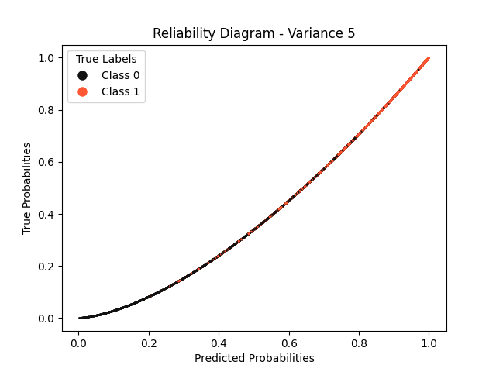
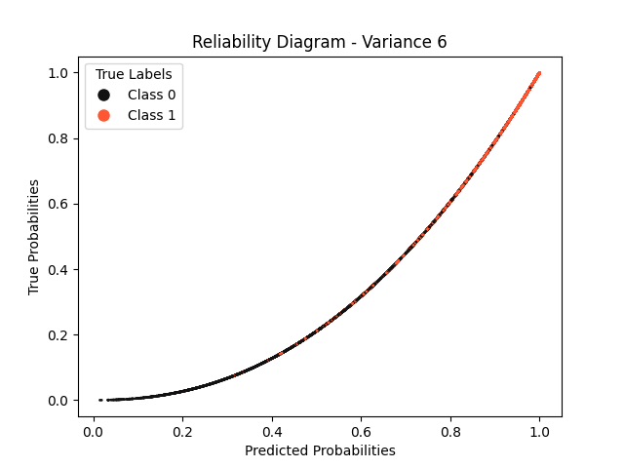
Reliability Diagrams – Variance Deviation (Dynamic Rescaling)

Slide 11
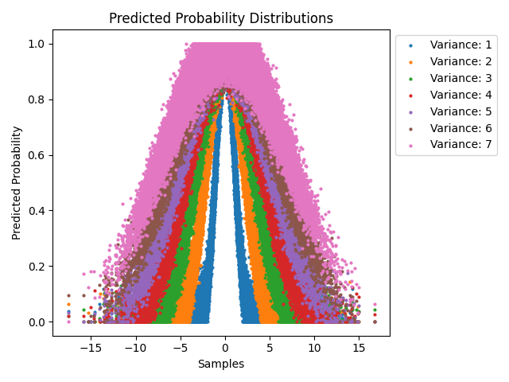
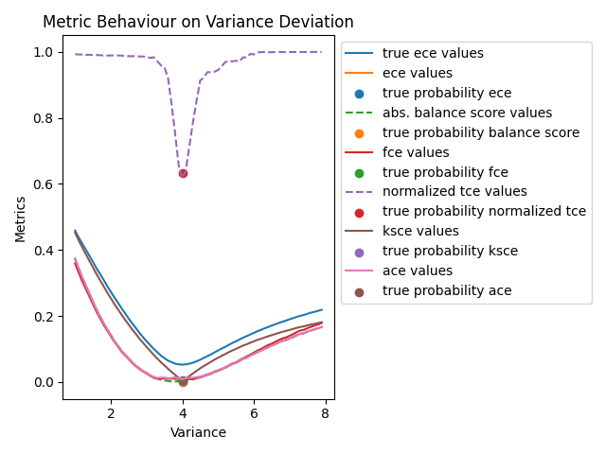
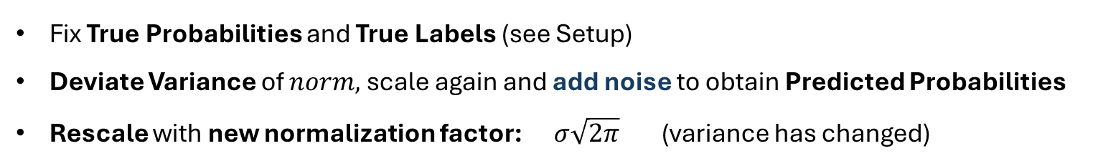
Variance Deviation (Dynamic Rescaling) with Noise
Qualitative Analysis
Fix True Probabilities and True Labels (see Setup)
Deviate Variance of $norm,$scale again and add noise to obtain Predicted Probabilities
Rescale with new normalization factor: $σ\sqrt{2π}$ (variance has changed)
$$yields$$
sample size: 40000; noise: random gaussian (mean=0, variance = 0.05)

Slide 12
Variance Deviation (Dynamic Rescaling) with Noise
Qualitative Analysis

Slide 13
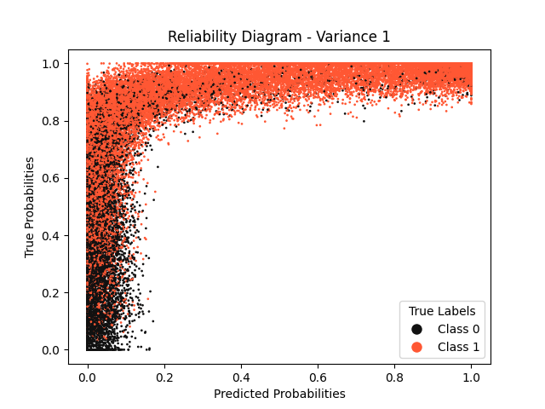
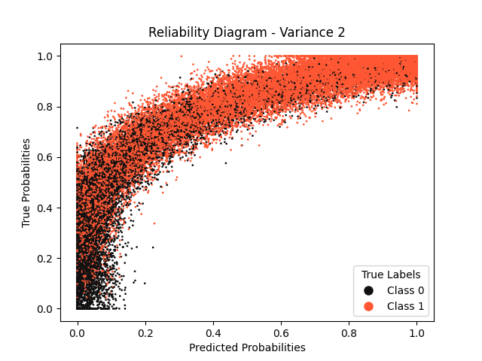
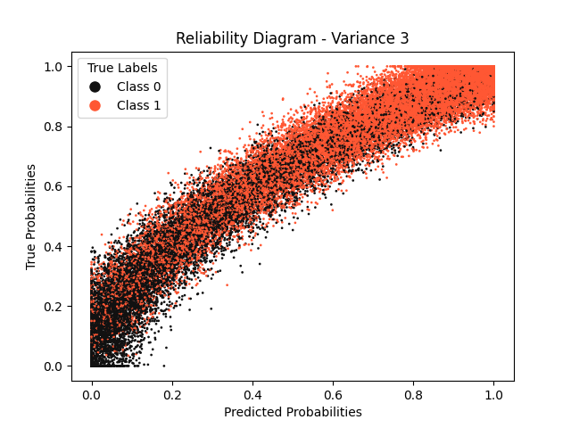
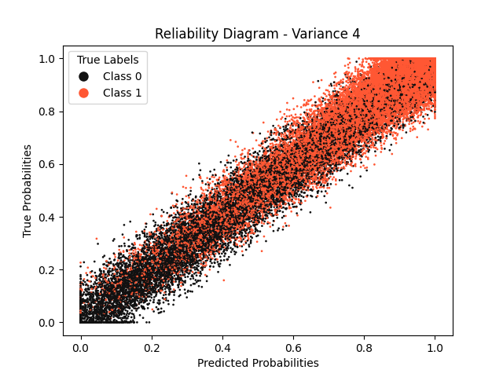
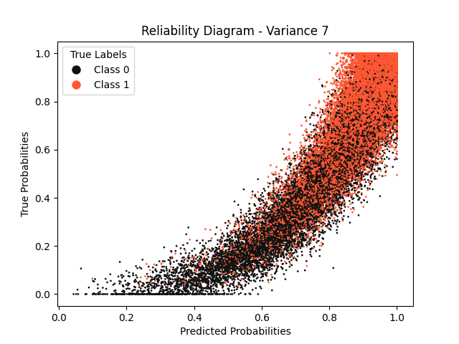
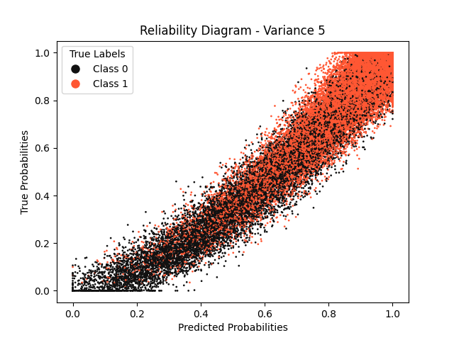
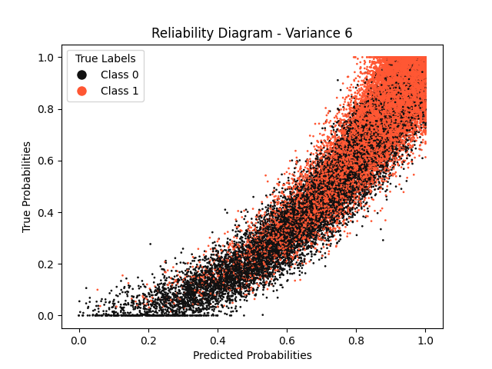
Reliability Diagrams – Variance Deviation (Dynamic Rescaling)
noise: random gaussian (mean=0, variance = 0.05)

Slide 14
Comparison without Noise - with Noise
Qualitative Analysis
Without Noise
With Noise
sample size: 40000; noise: random gaussian (mean=0, variance = 0.05)

Slide 15
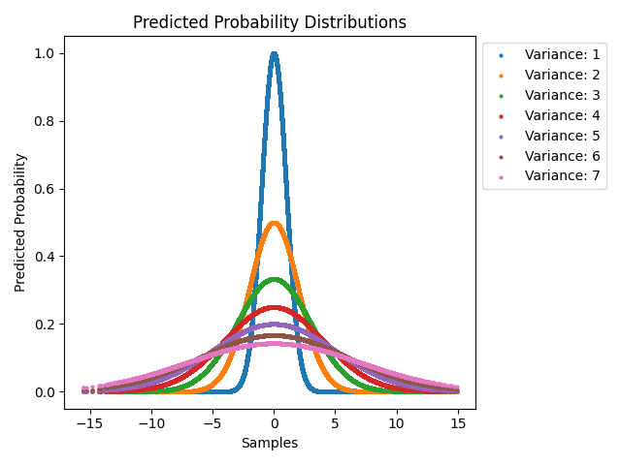
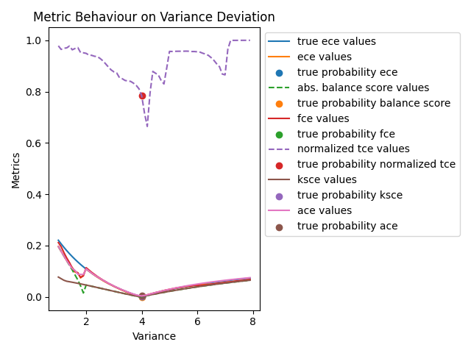
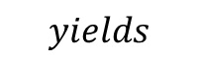
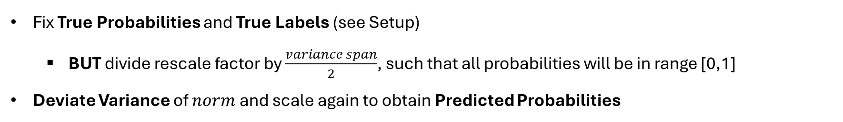
Variance Deviation (Static Rescaling)
Qualitative Analysis
Fix True Probabilities and True Labels (see Setup)
BUT divide rescale factor by $\frac{variance span}{2}$, such that all probabilities will be in range [0,1]
Deviate Variance of $norm$ and scale again to obtain Predicted Probabilities
$$yields$$
sample size: 40000

Slide 16
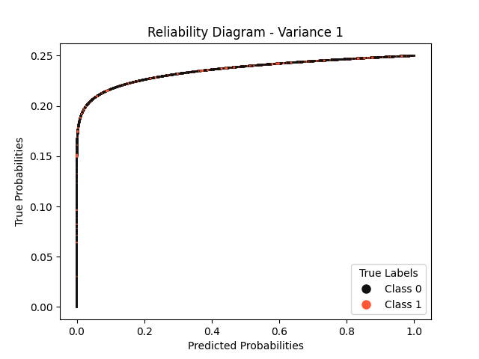






Reliability Diagrams – Variance Deviation (Static Rescaling)

Slide 17



Sine (Phase Shift)
Qualitative Analysis
Fix True Probabilities and True Labels (see Setup)
BUT replace $norm$with normalized sine wave: $\frac{1}{2}(\sin\left(x\right)+1)$ AND sample from uniform dist.
Deviate Sine Argument by adding a scalar value to $x$ to obtain Predicted Probabilities
$$yields$$
sample size: 40000; sample range: $[−π, π]$

Slide 18


Slide 19


Sample size: 100
Sample size: 1000

Slide 20





sample size: 40000; noise: gaussian;

Slide 21







Reliability Diagrams – Sine (Phase Shift)

Slide 22




Why is TCE so high?
Qualitative Analysis
Excerpt from Original Paper
Excerpt from Original Paper

Slide 23
Variance Deviation (Dynamic Rescaling) – Reduced Sample Size
Sample size: 100
Sample size: 1000

Slide 24



Noise Increase
Qualitative Analysis
Fix True Probabilities and True Labels (see Setup)
Add modified gaussian noise: $p=norm\left(0, step\right)∗{\left(p_{true}+0.1\right)\left(1.1 −p_{true}\right)}^{1.5} ∗10$
Clip to range [0,1]
$$yields$$
sample size: 40000
Notes:
Scaling by 10 is necessary to keep the noise effectively the same as „step“ +0.1 and 1.1 (instead of 1.0 adds base noise for probs exactly 0 and exactly 1)

Slide 25







Reliability Diagrams – Noise Increase

Slide 26





Case Simulation – Random Forest
$p=norm\left(0, 0.07\right)∗{\left(p_{true}+0.05\right)\left(1.05 −p_{true}\right)}^{1.5} ∗10$
clip to range [0,1]
$p=norm\left(0, 0.06\right)∗{\left(p_{true}+0.05\right)\left(1.05 −p_{true}\right)}^{1.5} ∗10$
clip to range [0,1.25] multiply by 0.8
sample size: 2000

Slide 27






Case Simulation – Support Vector Machine
$noise←norm\left(0, 0.02\right)∗{\left(p_{true}+0.1\right)\left(1.1 −p_{true}\right)}^{1.5} ∗10$
$p←\frac{1}{2^{1.1}} {\left(\sin\left(π∗p −1.5\right)+1\right)}^{1.1}$
$p←p ∗0.8+0.1+noise$
$noise←norm\left(0, 0.04\right)∗{\left(p_{true}+0.1\right)\left(1.1 −p_{true}\right)}^{1.5} ∗10$
$p←\frac{1}{2^{1.1}} {\left(\sin\left(π∗p+1.5\right)+1\right)}^{1.1}$
$p←p ∗0.8+0.1+noise$
clip to range [0,1.25]
multiply by 0.8
sample size: 2000

Slide 28






Case Simulation – Logistic Regression
$noise←norm\left(0, 0.01\right) ∗abs\left(p_{true}−0.5\right)∗4$
$p←p +noise$
clip to range [0,1.25]
$noise←abs(norm\left(0, 0.09\right))∗{\left(p_{true}+0.1\right)\left(1.1 −p_{true}\right)}^{1.5} ∗10$
$p←2 ∗{\left(1.1 ∗p_{true} −0.36\right)}^{3}+0.2$
$p←p ∗0.8+0.1+noise$
clip to range [0,1]
multiply by 0.8
sample size: 2000

Slide 29


Case Simulation – Neural Network
X_train, X_test, y_train, y_test = train_test_split(samples, labels, test_size=.2)
model = tf.keras.Sequential()
model.add(tf.keras.layers.Dense(50, activation="tanh"))
model.add(tf.keras.layers.Dense(2,activation="softmax"))
model.compile(optimizer="rmsprop", loss="categorical_crossentropy", metrics=["accuracy"])
model.fit(X_train.reshape(-1, 2), y_train, epochs=15, batch_size=1000)
sample size: 40000

Slide 30
Metric Evaluation – Case Simulation
Metrics | Random Forest 1 | Random Forest 2 | SVM 1 | SVM 2 | Logistic Regression 1 | Logistic Regression 2 | Neural Network
True ECE | 0.0485 | 0.033 | 0.048 | 0.0508 | 0.009 | 0.1105 | 0.0514
ECE (15) | 0.0259 | 0.011 | 0.0406 | 0.0188 | 0.0135 | 0.0246 | 0.022
Balance Score (abs.) | 0.0176 | 0.011 | 0.006 | 0.0096 | 0.0021 | 0.0224 | 0.022
FCE (15) | 0.026 | 0.011 | 0.041 | 0.019 | 0.014 | 0.025 | 0.026
TCE (15, norm.) | 0.4013 | 0.1995 | 0.577 | 0.3375 | 0.2748 | 0.6975 | 0.61
KSCE | 0.01474 | 0.0112 | 0.012 | 0.0231 | 0.0053 | 0.0747 | 0.021
ACE (15) | 0.0251 | 0.0228 | 0.043 | 0.0213 | 0.0161 | 0.035 | 0.022
Italic : True ECE Bold : Closest to True ECE Underlined : Second Closest to True ECE Sample Size: 4000

Slide 32



Variance Deviation (Dynamic Rescaling) with Noise, Isotonic Regression
Qualitative Analysis
Fix True Probabilities and True Labels (see Setup)
Deviate Variance of $norm,$rescale and add noise & Isotonic Regression to obtain Predicted Probabilities
Rescale with new normalization factor: $σ\sqrt{2π}$ (variance has changed)
$$yields$$
sample size: 40000; noise: random gaussian (mean=0, variance = 0.05)

Slide 33







Reliability Diagrams – Variance Deviation (Dynamic Rescaling) with Noise and Isotonic Regression
noise: random gaussian (mean=0, variance = 0.05)

Slide 34

Grid Search SVM
sample size: 8400

Slide 35






Reliability Diagrams – Grid Search: SVM with RBF Kernel
C: 0.1
C: 1
C: 10
Gamma: scale
Gamma: auto
sample size: 8400

Slide 36






Reliability Diagrams – Grid Search: SVM with Linear Kernel
C: 0.1
C: 1
C: 10
Gamma: scale
Gamma: auto
sample size: 8400

Slide 37






Reliability Diagrams – Grid Search: SVM with Sigmoid Kernel
C: 0.1
C: 1
C: 10
Gamma: scale
Gamma: auto
sample size: 8400

Slide 38



SVM Interpolation
Qualitative Analysis
Fix True Probabilities and True Labels (see Setup)
Transform with Sigmoid Function & add Modified Gaussian Noise to obtain Predicted Probabilities $p ←1 / (1 +exp⁡(− step (p − 0.5))$
$$yields$$
sample size: 40000; noise: modified gaussian (step=0.015)

Slide 39









Reliability Diagrams – SVM Interpolation

Slide 40
Varying Sample Size
Experiments
Fix Dataset
Vary Number of Samples Drawn from Dataset
Train Models:
Neural Network
SVM
Logistic Regression
Random Forest
Evaluate Metrics for each Sample Size
sample size: 40000; sample range: $[−π, π]$

Slide 41






Datasets – Varying Sample Size
Samples: 100
Samples: 1000
Samples: 5000
Samples: 10.000
Samples: 40.000
Samples: 80.000
sample size: 8400

Slide 42






Evaluation – Varying Sample Size
Samples: 100
Samples: 1000
Samples: 5000
Samples: 10.000
Samples: 40.000
Samples: 80.000
Seems to highly depend on how good a model is??

Slide 43






Evaluation – Varying Sample Size (SVM Kernel: rbf instead of linear)
Samples: 100
Samples: 1000
Samples: 5000
Samples: 10.000
Samples: 40.000
Samples: 80.000

Slide 44
New Idea – Varying Sample Size
Use Grid Search to find good or optimal Model beforehand?
Then only use the good Models?

Slide 45




Evaluation – Varying Sample Size on SVM – Iterations: 20

Slide 46



Evaluation – Varying Sample Size on SVM – Iterations: 20

Slide 47


Slide 50






Slide 51





